Slide 1

TEAM IT
Meeting Arteng Juli 2022

Slide 2
Implementasi
1

Slide 3
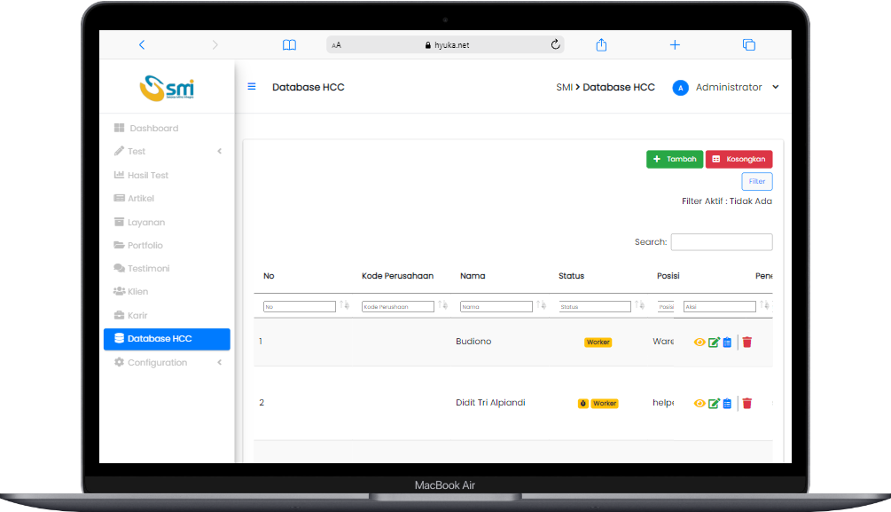
Website Database HCC
Penyesuaian dashboard Fico, export excel sesuai filter, history seleksi pelamar

Slide 4
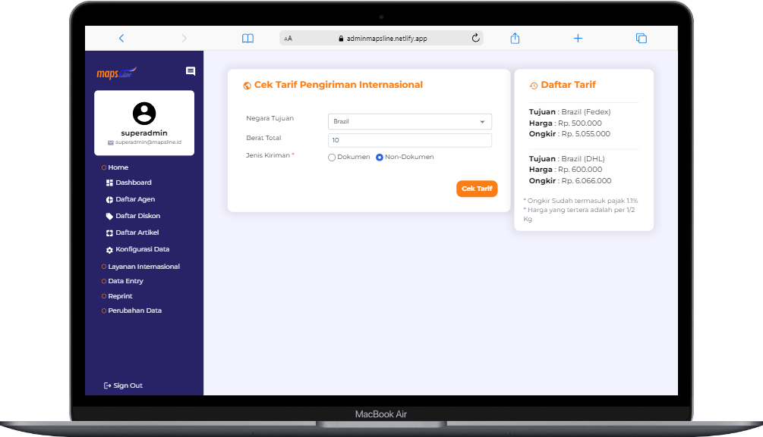
Website Mapsline
Customisasi filter cek tarif

Slide 5
Sedang Berjalan
2
(On Process)

Slide 6
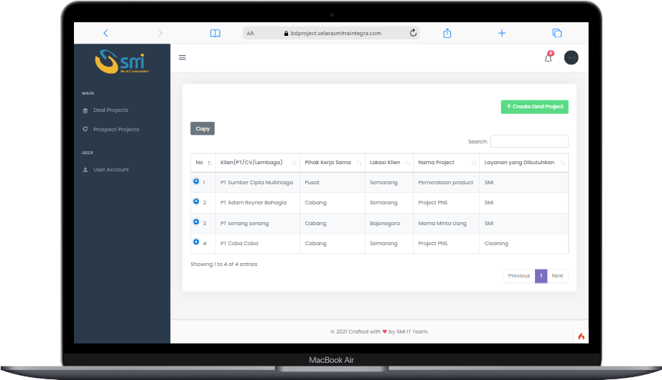
Website BD Project Management
Penambahan fitur cancle dealing di menu deal project
*dikerjakan oleh mas Firdaus

Slide 7
On Process
Recruitment IT
Pengembangan web Database HCC & HRO
Transfer learning

Slide 8
Next Progress
3

Slide 9
Next Process
Pengadaan untuk pembuatan environment IT yang ideal
Aplikasi mobile kurirQu

Slide 10
THANKS!
Any questions?

